Slide 1
Biological Background

Slide 2
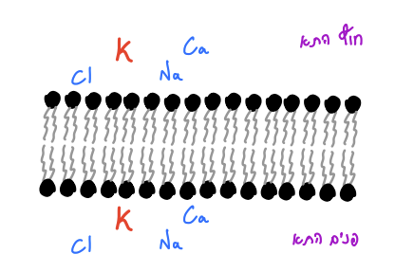
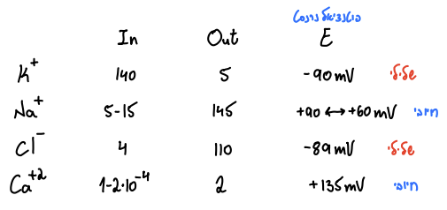
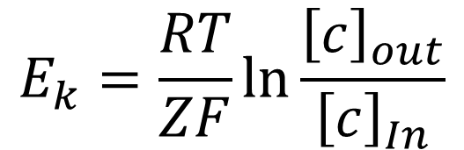
פוטנציאל נרנסט
$$E_{k}=\frac{RT}{ZF}ln\frac{{\left[c\right]}_{out}}{{\left[c\right]}_{In}}$$

Slide 3
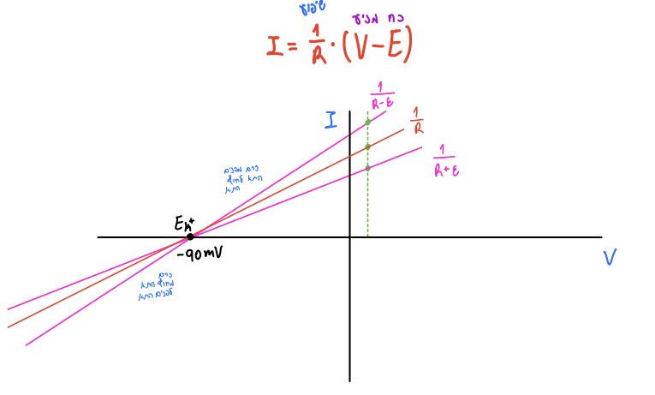

Slide 4
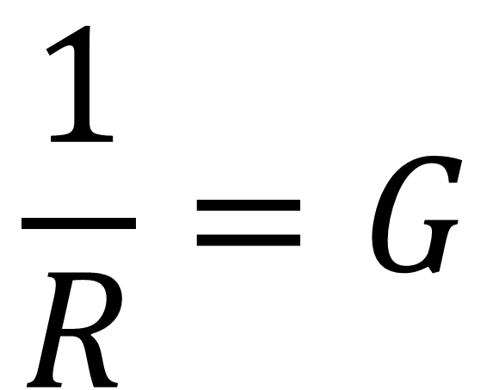
$$\frac{1}{R}=G$$

Slide 5
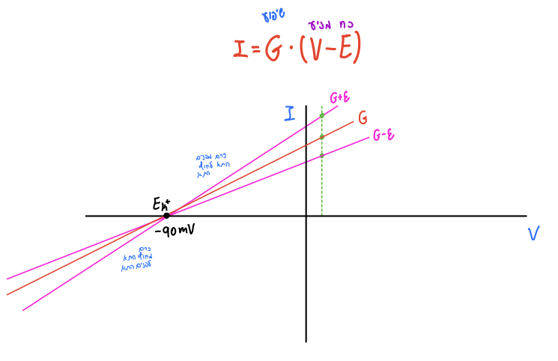
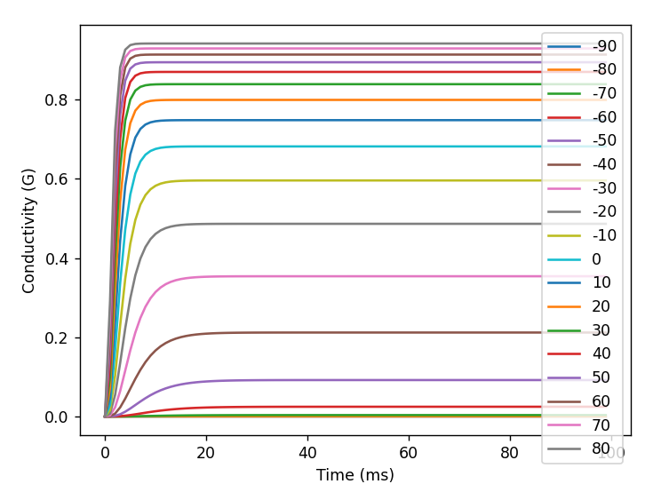

Slide 6
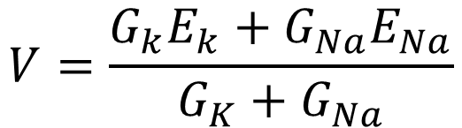
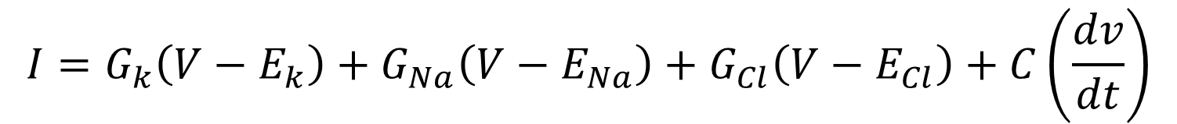

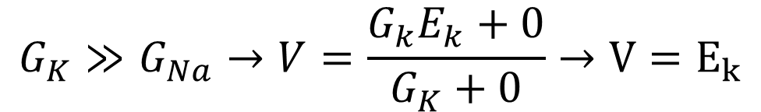
$$I=G_{k}\left(V−E_{k}\right)+G_{Na}\left(V−E_{Na}\right)+G_{Cl}\left(V−E_{Cl}\right)+C\left(\frac{dv}{dt}\right)$$
$$V=\frac{G_{k}E_{k}+G_{Na}E_{Na}}{G_{K}+G_{Na}}$$
$$G_{K}≫G_{Na}→V=\frac{G_{k}E_{k}+0}{G_{K}+0}→V=E_{k}$$
$$V>E_{k}→G_{k} is Big$$

Slide 8
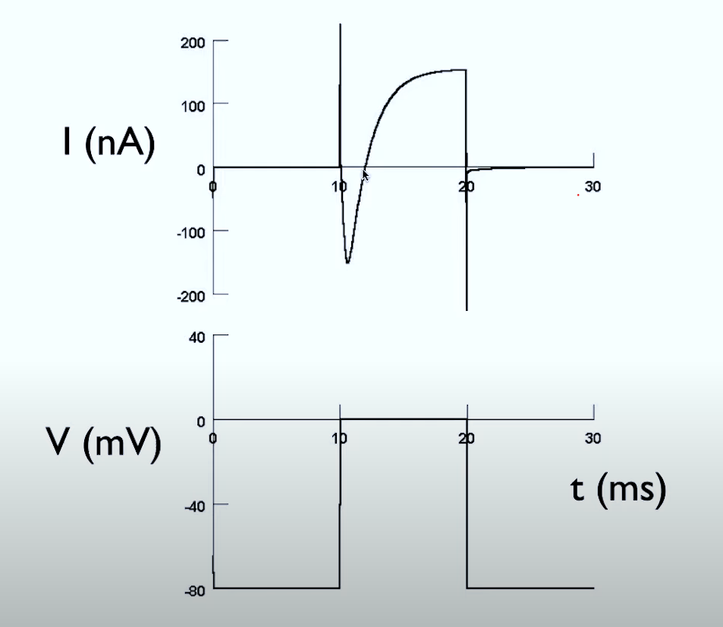
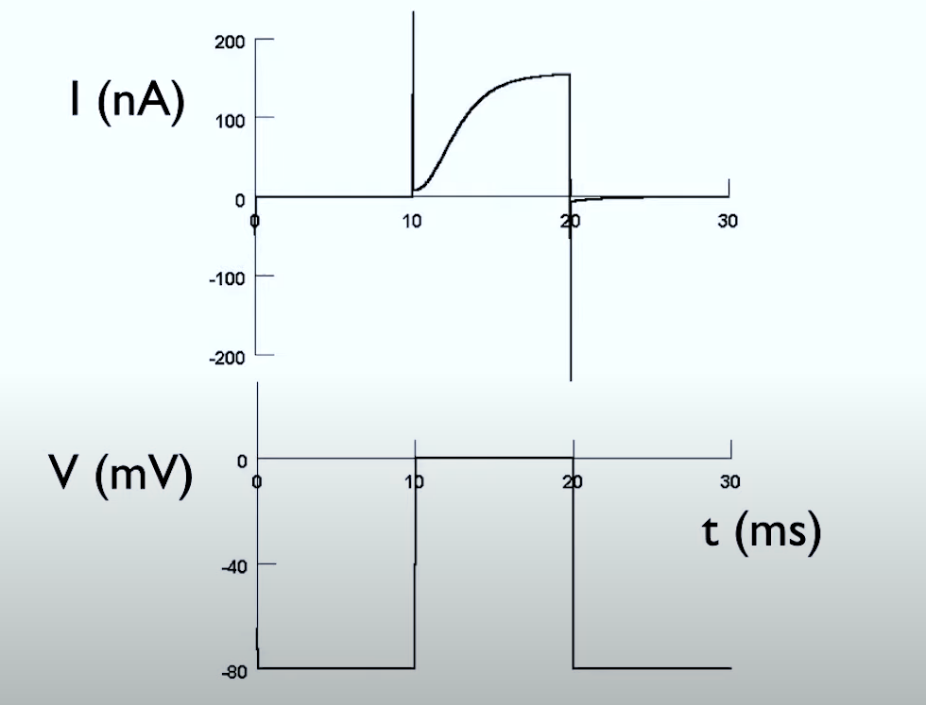
Voltage Clamp – Hodgkin and Huxley

Slide 9
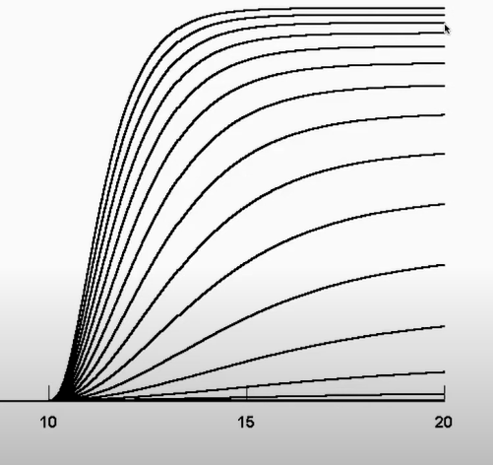
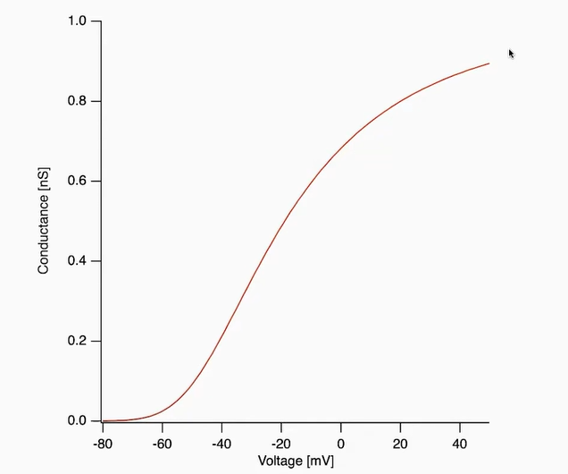
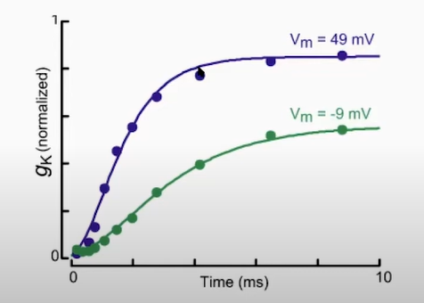

Slide 10
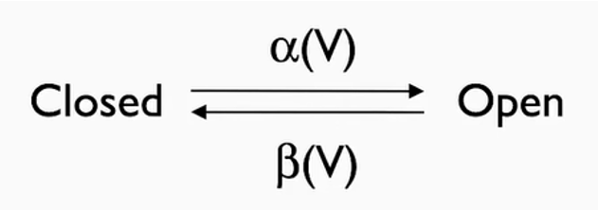
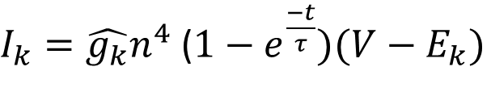
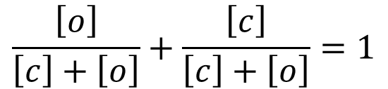
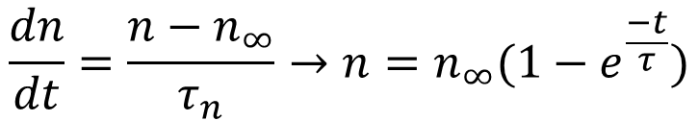
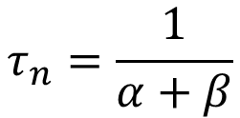
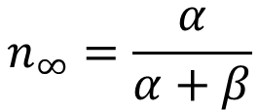
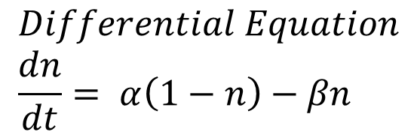
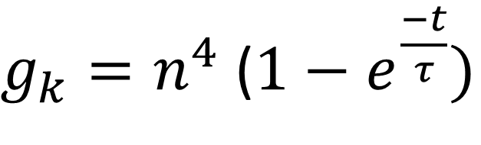
$$n_{∞}=\frac{α}{α+β}$$
$$τ_{n}=\frac{1}{α+β}$$
$$\frac{dn}{dt}=\frac{n−n_{∞}}{τ_{n}}→n=n_{∞}(1−e^{\frac{−t}{τ}})$$
Open fraction
close fraction
$$\frac{\left[o\right]}{\left[c\right]+\left[o\right]}+\frac{\left[c\right]}{\left[c\right]+\left[o\right]}=1$$
$I_{k}=\hat{g_{k}}n^{4}$ ($1−e^{\frac{−t}{τ}})(V−E_{k})$
n
1-n
$g_{k}=n^{4}$ ($1−e^{\frac{−t}{τ}})$
$$Differential Equation \\ \frac{dn}{dt}= α\left(1−n\right)−βn$$

Slide 11
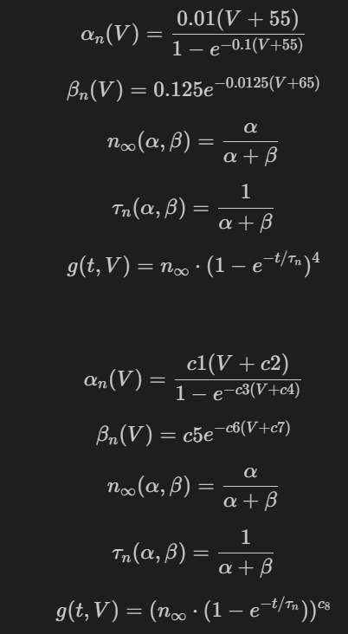
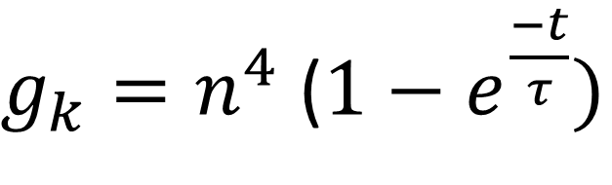
$g_{k}=n^{4}$ ($1−e^{\frac{−t}{τ}})$

Slide 12
Project Workflow

Slide 13
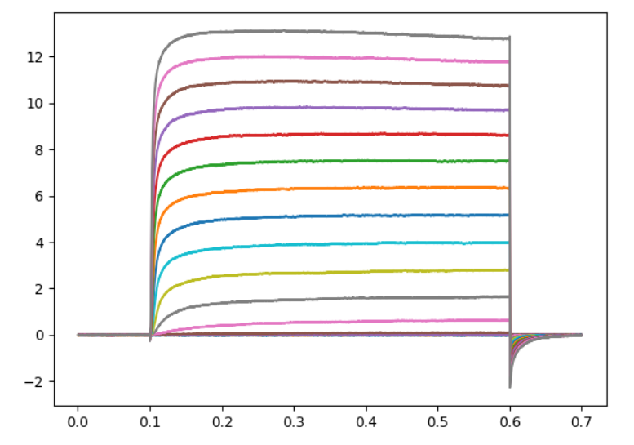
1. Getting and filtering ChannelPedia data

Slide 14
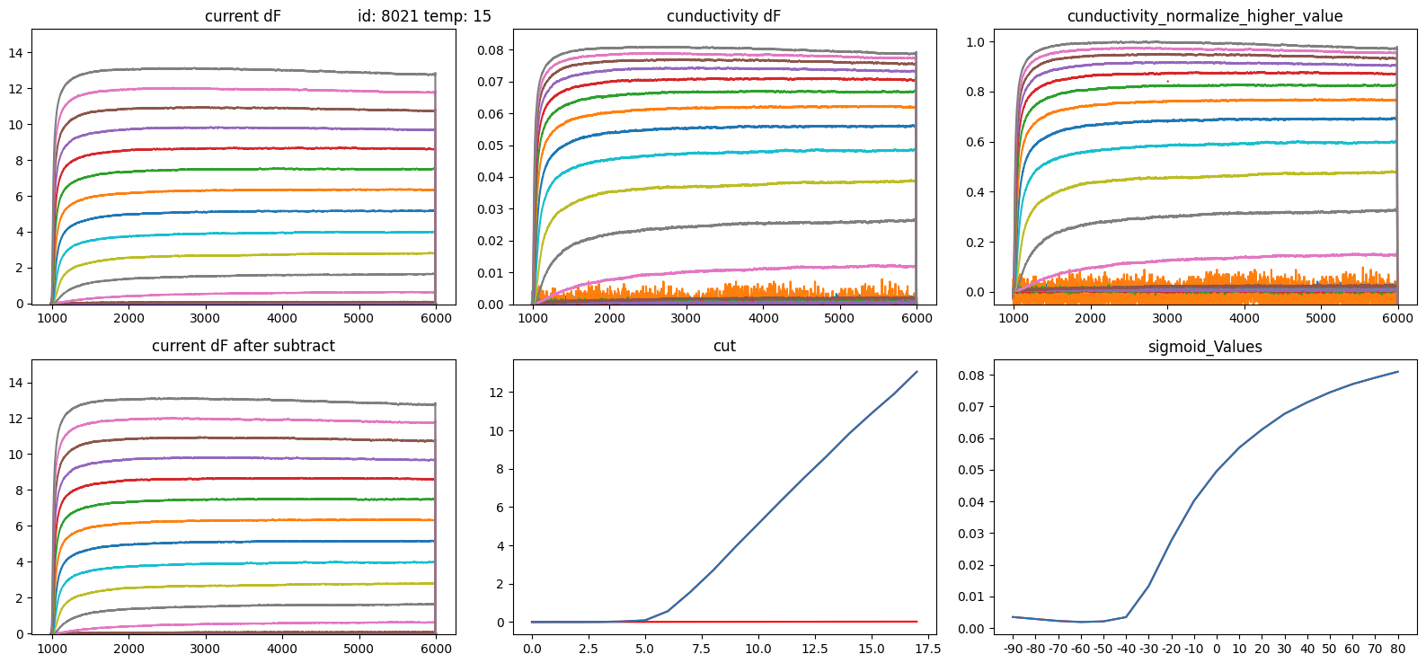
2. Getting conductivity from current and normalizing

Slide 15
3. Generating data for a sanity check by known equations and parameters

Slide 16
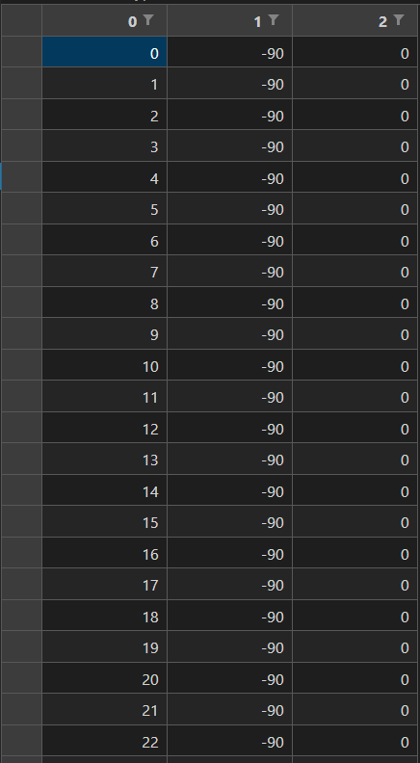
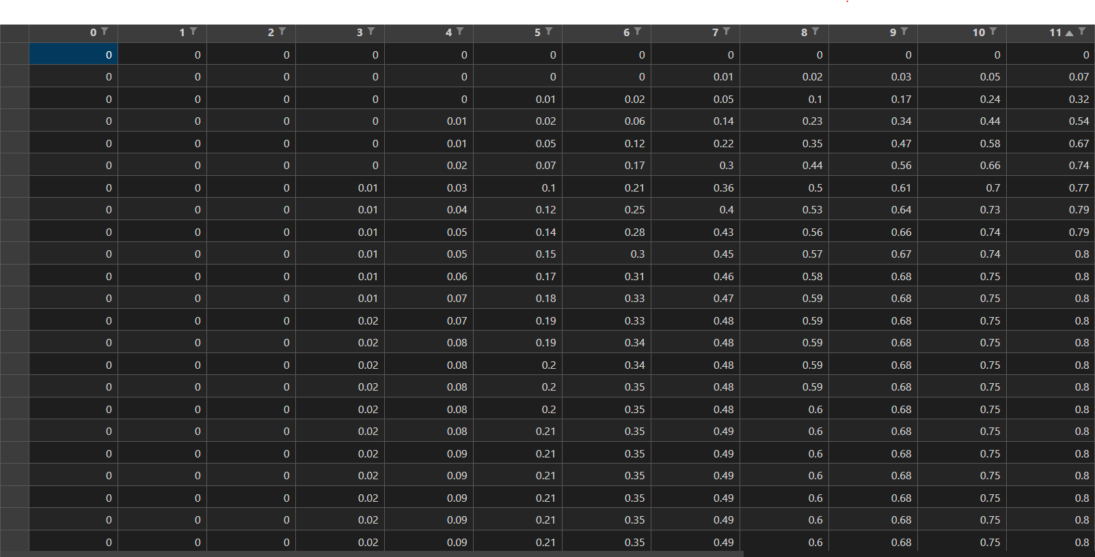
3*1800
18x100

Slide 17
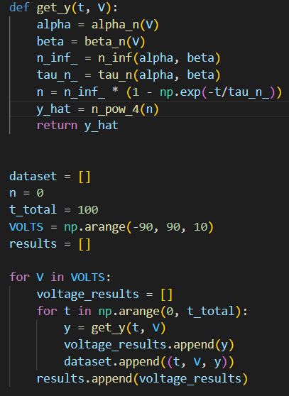

t, V
64, -30
c1 c2 c3 c4 c5 c6 c7 c8
0.01 55 0.1 55 0.125 0.0125 65 4
G(t, V)
0.354114817547396

Slide 18
4. Defining the problem
Given 2 time constants α={c1, c2, c3, c4}, β = {c5, c6, c7} and c8 (for power). We want to find a Model M that finds those parameters given the data that was created by those parameters (Sanity check – Squid).
In the second phase, using Model M we found, we want to find the parameters: α={c1, c2, c3, c4}, β = {c5, c6, c7} and c8 (for power) for the data we got from ChannelPedia
Sanity check – Squid
CahnnelPedia - Rats
c1 c2 c3 c4 c5 c6 c7 c8 +
Our generated Data
c1 c2 c3 c4 c5 c6 c7 c8 +
ChannelPedia Data
Model M
Model M
0.01 55 0.1 55 0.125 0.0125 65 4
? ? ? ? ? ? ? ?

Slide 19
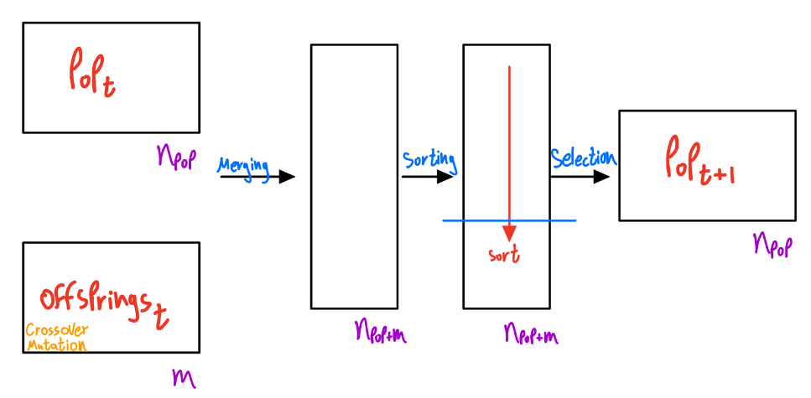
5.1 Using Genetic algorithm as Model M
Loss based

Slide 20
5.2 Genetic Algorithm Pros and Cons
Pros
No optimizer is used, therefore the convergence to low loss values ​​does not depend on updating a set of weights determined based on the loss derivative.
A big set of hyperparameters to be used to adjust the model
The algorithm converges to a global minimum when parameters are set
Cons
Does not contain a set of weights. therefore, this algorithm is not a learning algorithm. In the case of new data, we cannot use the previous results
A big set of hyperparameters to be used to adjust the model
Fails to avoid local minima when trying to run with non-fixed parameters
In the future it will be difficult to say whether the parameter values ​​that will be obtained for the data are the correct parameters and it will be difficult to gauge this in terms of statistical significance

Slide 21
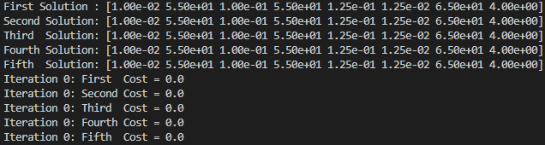
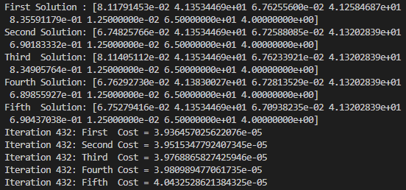
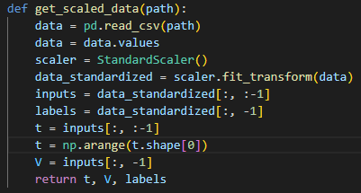
6. Main Challenges
Validating equation sets that generate the data
Local Minima
Non-normalized values generated the data
Lack of computational power

Slide 22
7. Arsenal
Arsenal
Loss evaluator for 2 loss functions (If there is linearity between 2 loss functions)
EDA code for the original data
EDA code for the GA Hyperparameters optimization
Boxplot representation for GA hyperparameters preferences
Correlation representation for GA hyperparameters preferences
Local minima estimator (No output yet)
Option to optimize only certain parameters in GA and leave the rest constants

Slide 23
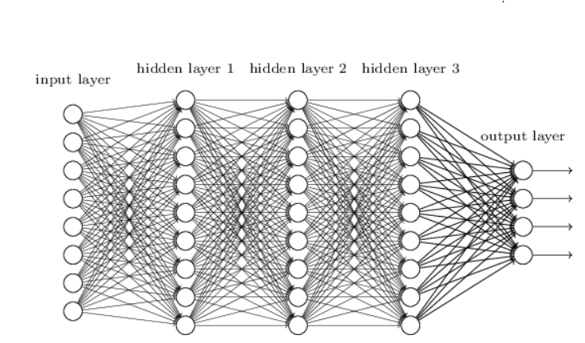

8. Ideal solution
1800
8
Loss comparison
G values
Backprop
Local Minima ???
We can generate a lot of data by using the sets of equations and choosing linespace of Voltages and use the known parameters.

